Slide 1

DATA SCIENCE SALARIES 2023
Tejalakshmi Gangadhar Chalumuri ​
Daniel Nehemiah Peter Katam
Sai Sujith Reddy Jupalli ​

Slide 2
Outcome: The analysis of this data will be useful in several ways. It will help companies in determining the salary range for different job titles and experience levels. It will also help job seekers in negotiating their salaries and understanding the factors that affect the salary.
Goal:
The purpose of this report is to analyse the Data Science Salaries 2023 dataset. This dataset contains information about salaries, job titles, employment types, company locations, and company sizes of individuals working in the field of data science.
Data science salaries dataset is highly relevant for those interested in understanding the current job market in data science.
By analysing this dataset, we can gain insights into the most in-demand skills and the locations with the highest salaries for data science jobs in the upcoming year.

Slide 3
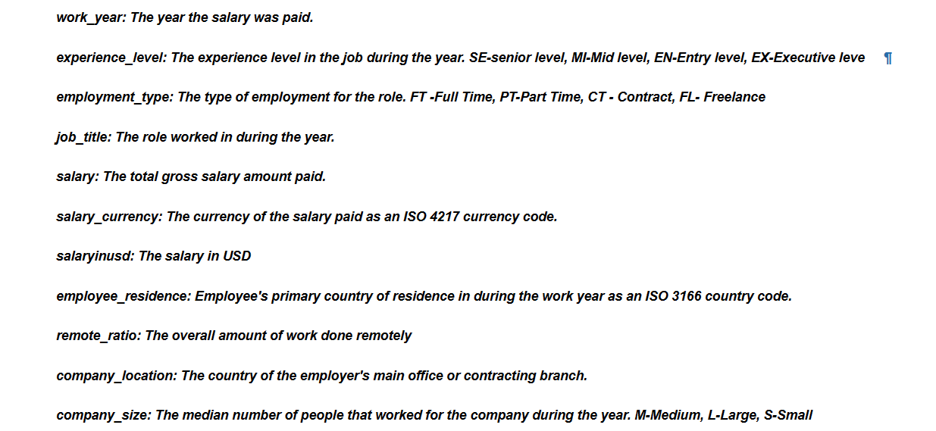
Description of columns

Slide 4
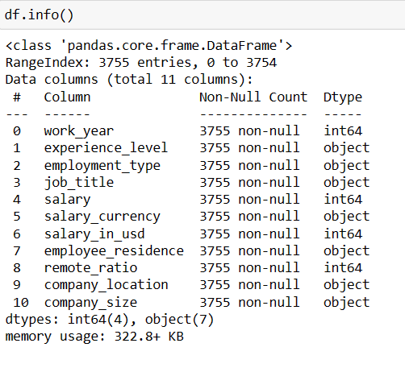
Information about dataset :
We have used info command to get an overview of the dataset
As we can see from the table there are 4 integer and 7 object features
There are no null values
Memory used to store the dataset
Total number of columns and rows and the titles of the columns

Slide 5
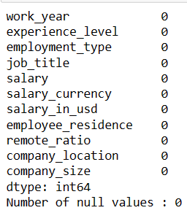

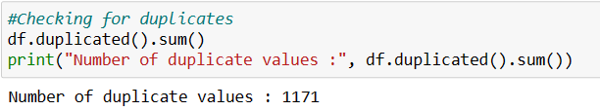
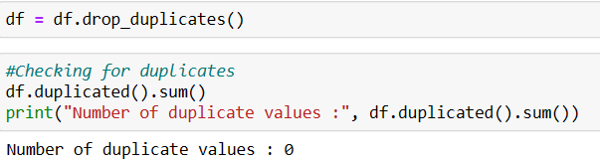

Cleaning and Wrangling

Slide 6
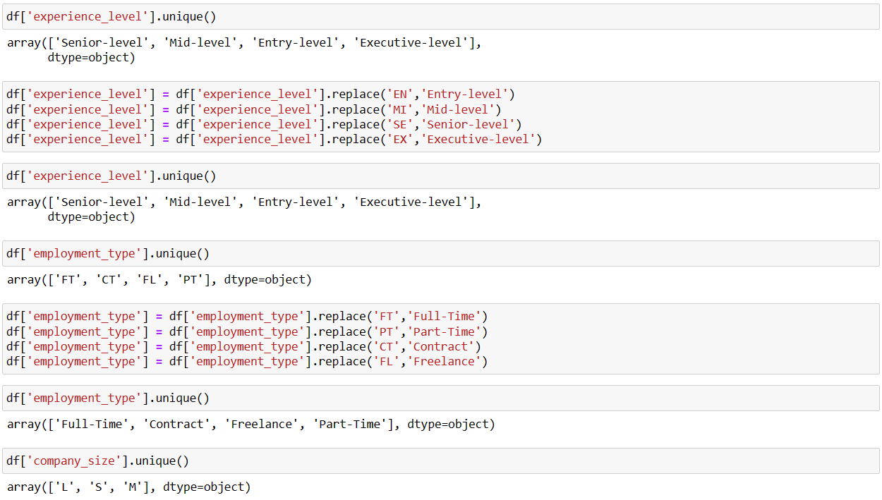
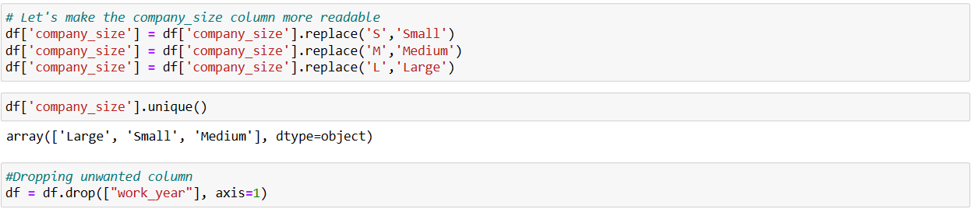
Making data more readable

Slide 7
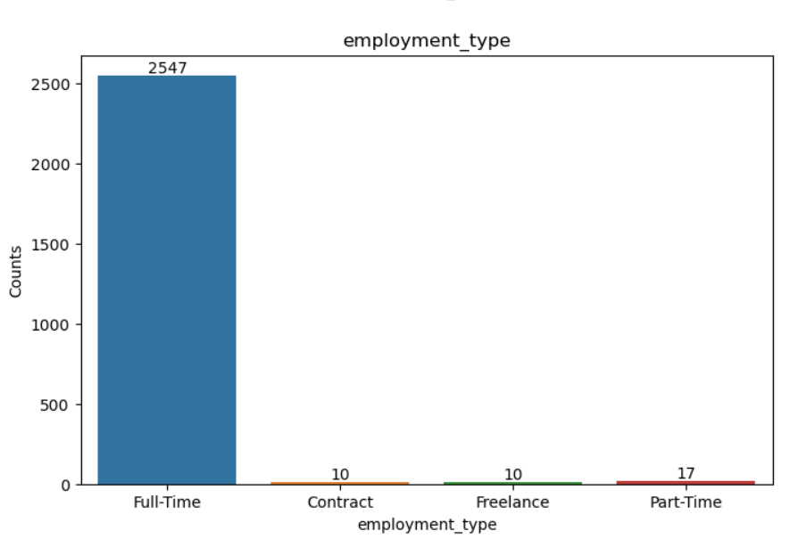
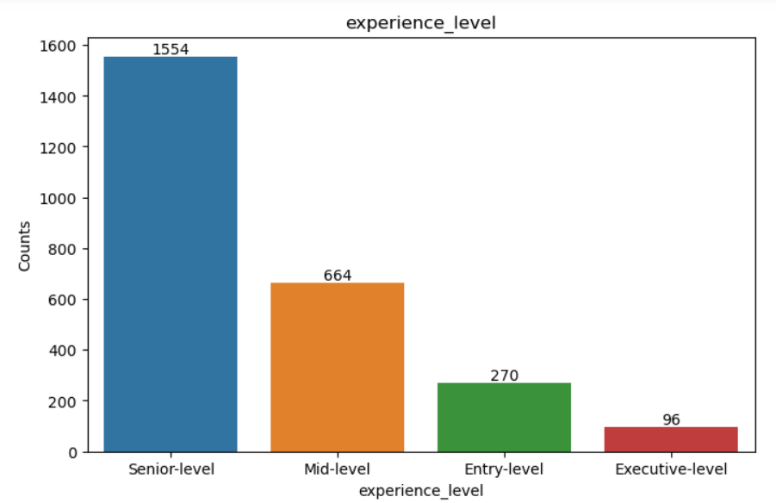
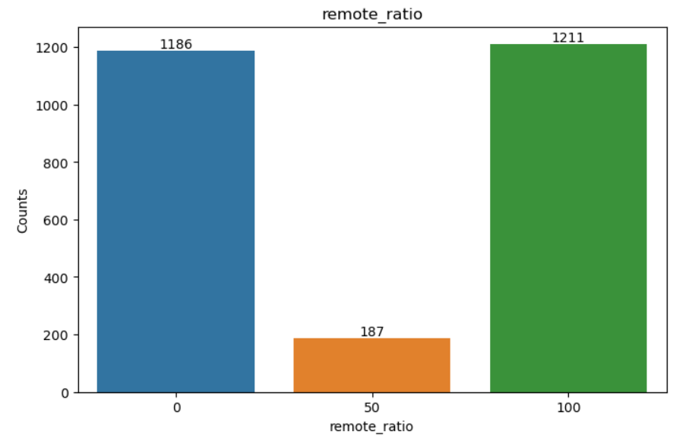
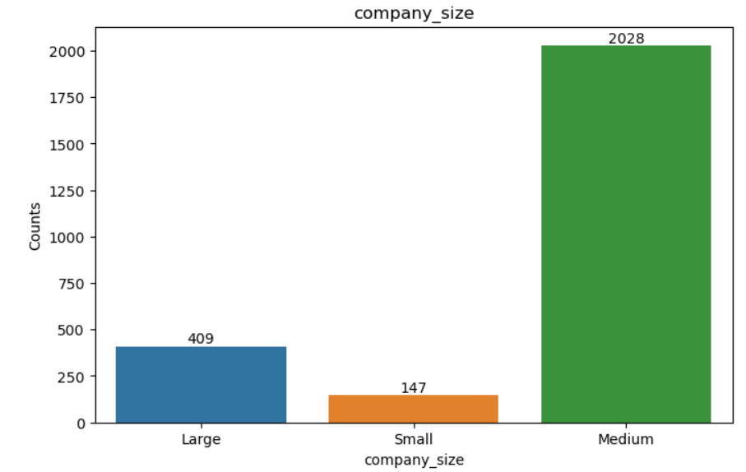
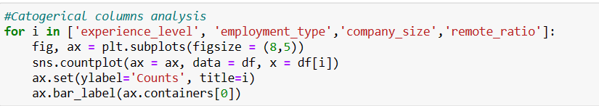
Data Visualization
We used count plot to analyze the categorical features
As we can see from first chart full time employment is the most common
Most of the job profiles are at senior level
And most of the job are either 100% remote or 100% work from office
Medium size companies are hiring more data scientist rather than large and small

Slide 8
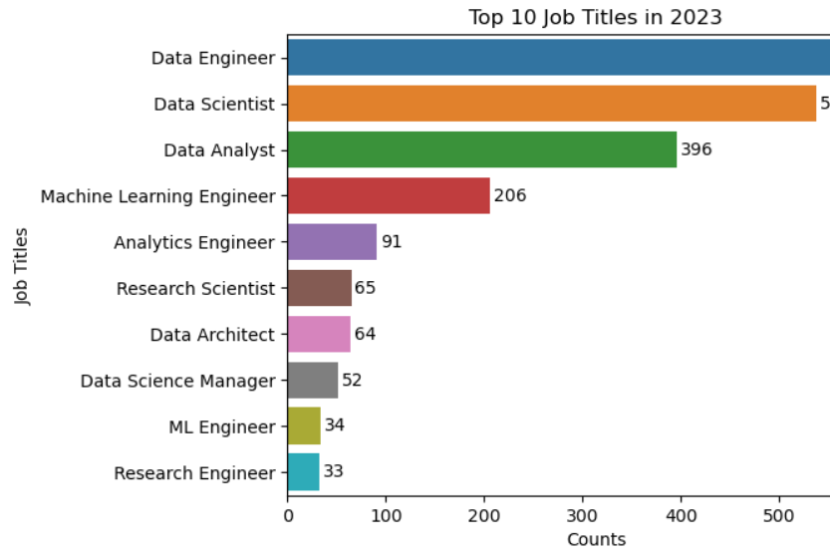
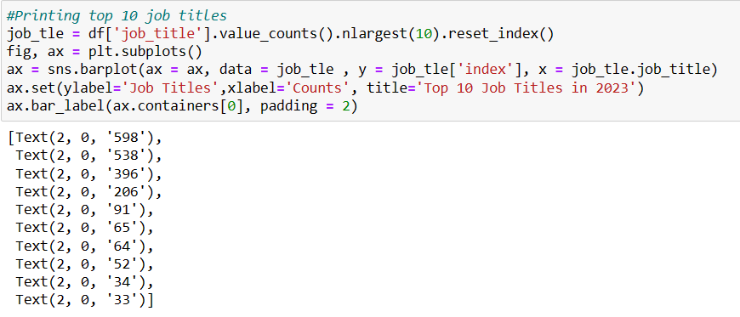
Printing top 10 preferred job titles

Slide 9
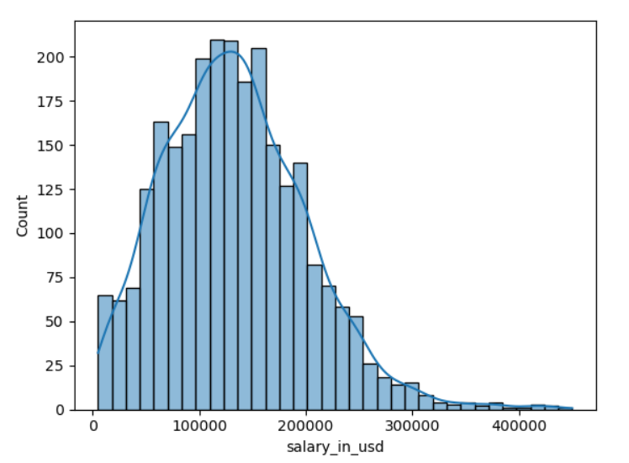
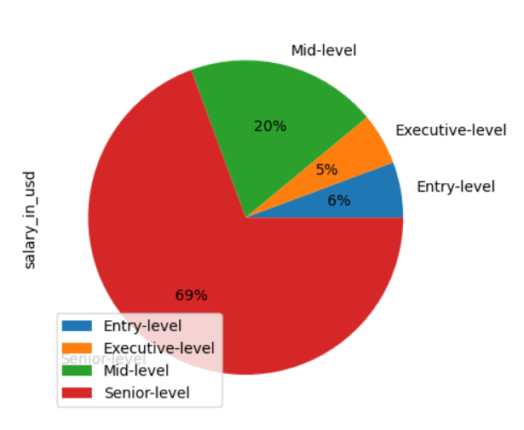
Checking the spread of salary_in_usd & pie plot to see the salary offered to different level of experience levels

Slide 10
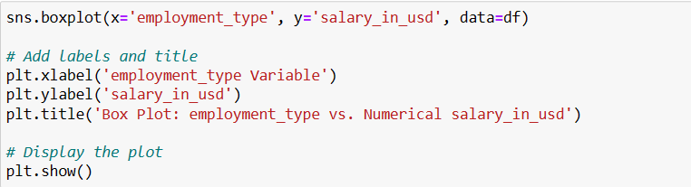
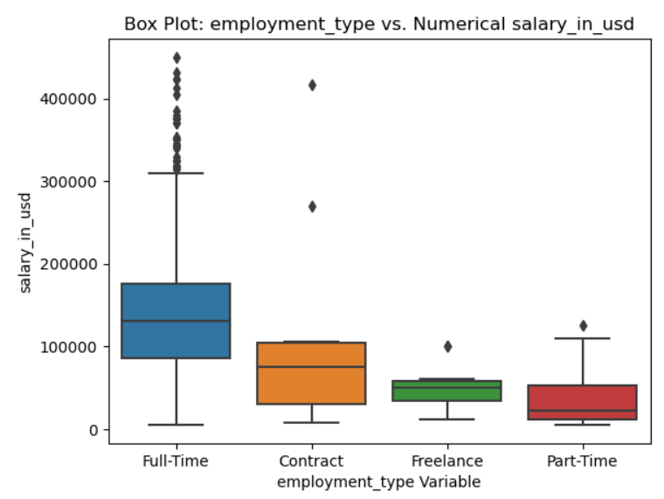
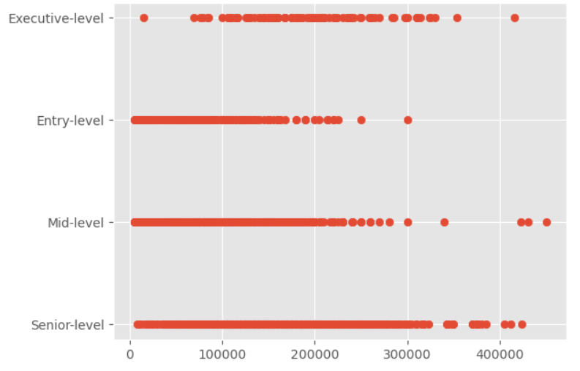
Using Bivariate analysis and creating box and scatter plot to see the relation between salary in usd to employment type and experience level

Slide 11
Data Visualization
We used count plot to analyze the categorical features
As we can see from first chart full time employment is the most common
Most of the job profiles are at senior level
And most of the job are either 100% remote or 100% work from office
Medium size companies are hiring more data scientist rather than large and small

Slide 12
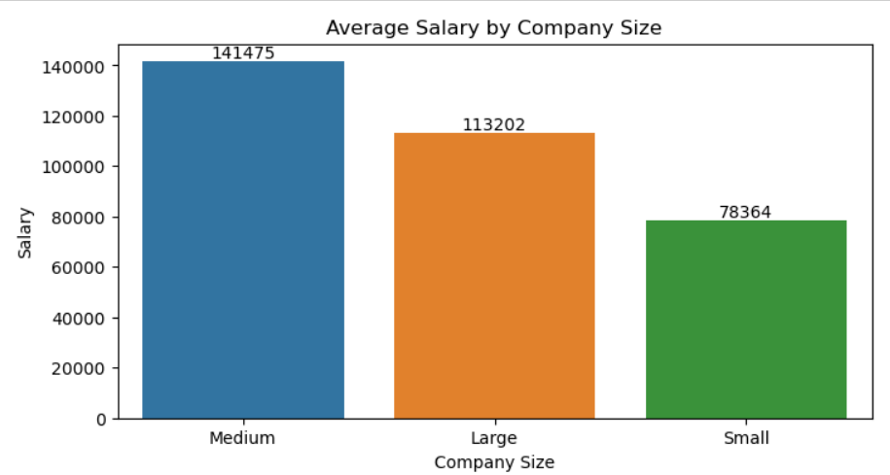
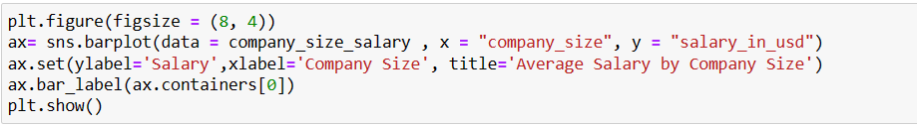
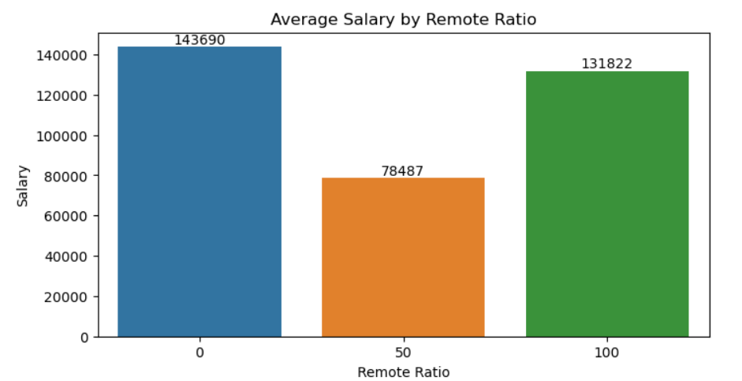
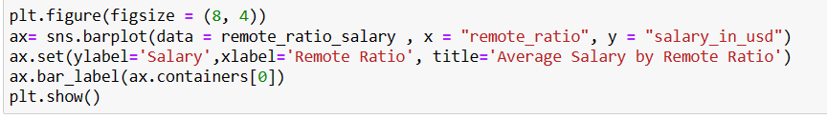
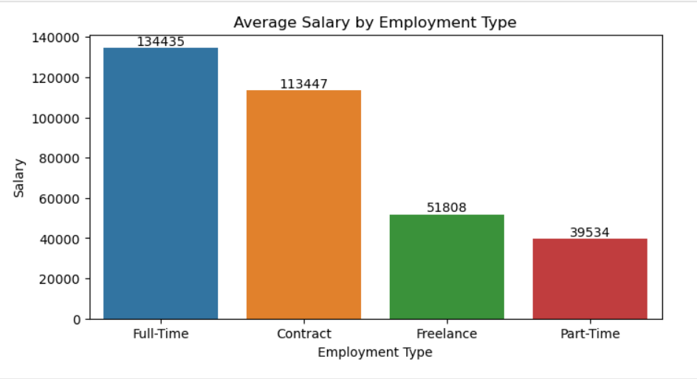
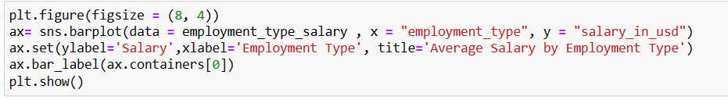

Slide 13
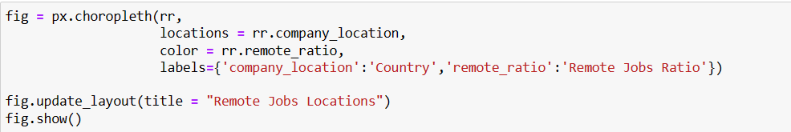
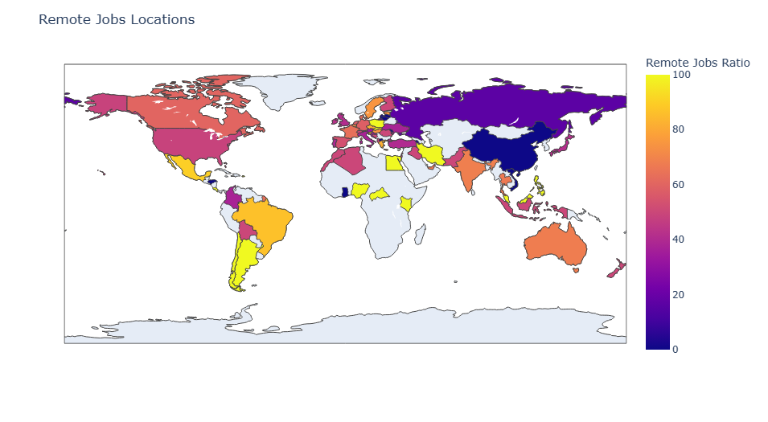
Creating World maps to see the spread of features across the world
As we can see from the map that South America is having the most amount of remote where in India, Australia and Canada is moderate but when it comes to Russia its almost close to 0%

Slide 14
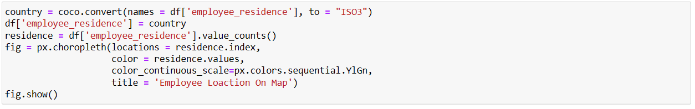
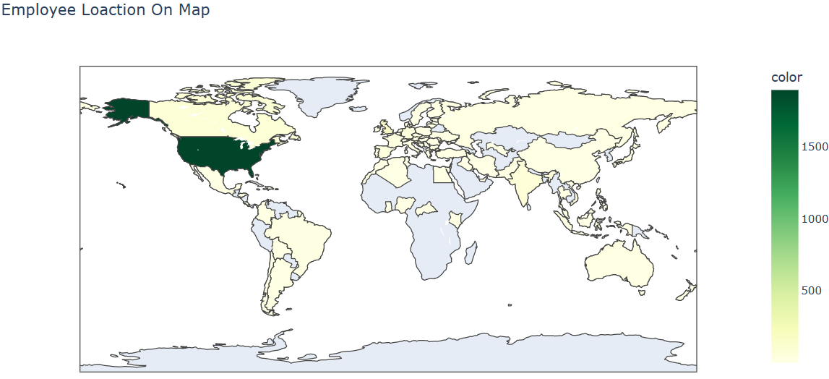
Creating World maps to see the spread of features across the world
As we can see from the map that USA is having the most amount of data scientist employees living but when it comes to other countries they are very low

Slide 15
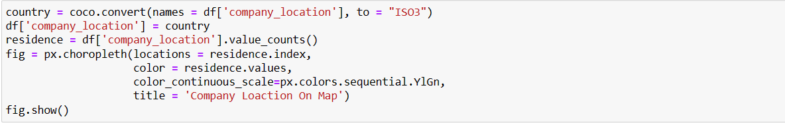
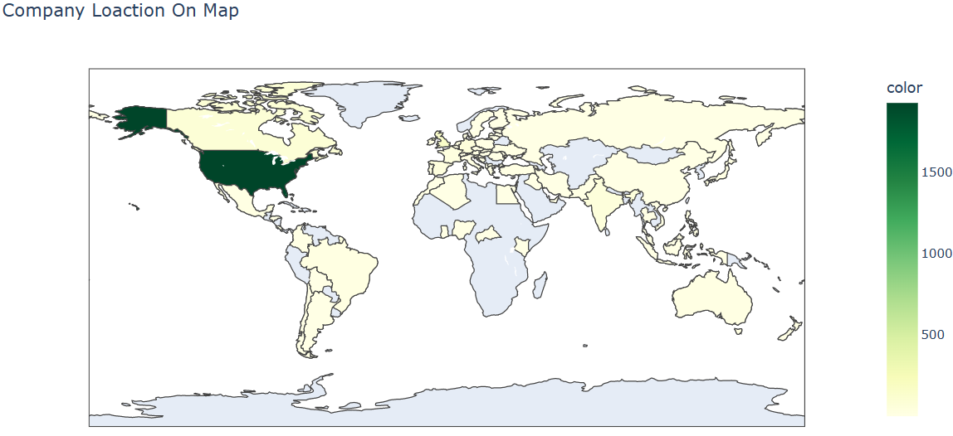
Creating World maps to see the spread of features across the world
As we can see from the map that USA is having the most amount companies which are offering data scientist jobs but when it comes to other countries, they are very low

Slide 16
Linear Regression model

